Slide 1


THE LNM INSTITUTE OF INFORMATION TECHNOLOGY
DIABETIC RETINOPATHY
DETECTION
AND
CLASSIFICATION
HARSHIL GUPTA (20UEC055)
HARSHIT CHAUHAN (20UEC057)
LAKSHYA GUPTA (20UEC075)
SUPERVISED BY:
DR. JOYEETA SINGHA

Slide 2
INTRODUCTION
1
OBJECTIVE AND MOTIVATION
2
Table of Contents
LITERATURE SURVEY
3
BRIEF RECAP SYSTEM 1 & 2
4
PROPOSED SYSTEM 3
5
CONCLUSION
6
REFERENCES
7

Slide 3
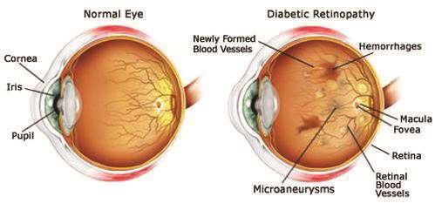
INTRODUCTION
“Diabetic retinopathy” is an eye disease highly prone to the diabetic patients and major causes of loss of vision and blindness in patients.
Blood vessels in Retina get damaged due to the high blood sugar level, and this can result to the leakage of a fluid causing the Macula to swell.
Figure1. Diagram of normal eye and diabetic retinopathy eye [11]
(3)

Slide 4
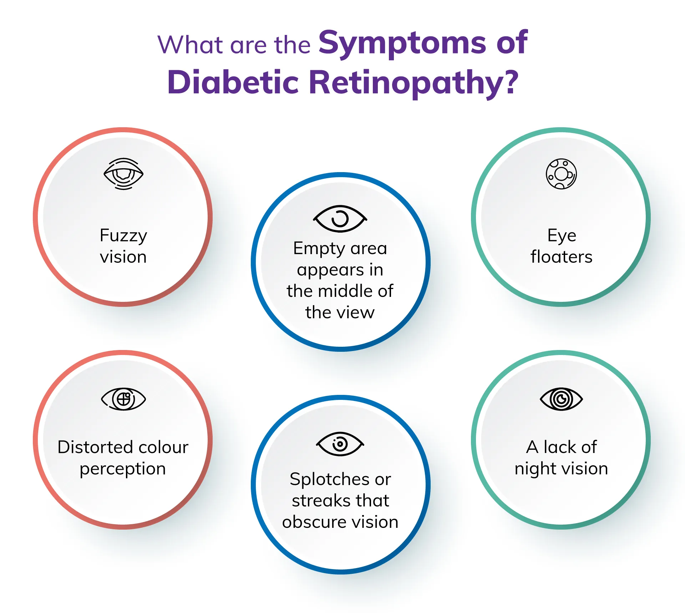
Diagnosing at an early stage can help oneself save their vision.
As It might cause trouble reading or seeing faraway objects in future.
As the infection becomes progresses,
following kind of symptoms will arise:
  Figure 2. Symptoms of diabetic retinopathy [12]
  (4)

Slide 5
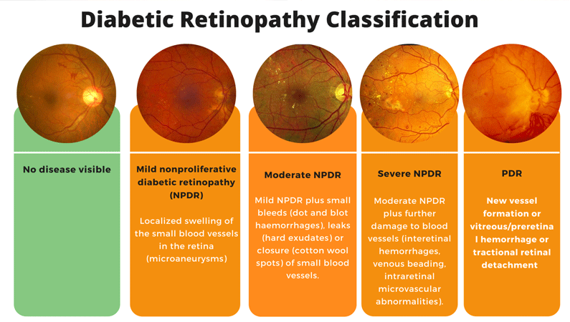
Classification of DR
(5)

Slide 6
OBJECTIVE
The major objective of the proposed research is to contribute towards enhancing the diagnosis of a diabetic retinopathy by providing an alternative deep learning methods for early detection of Diabetic retinopathy that is possibly more accurate than the existing published literature survey.
(6)

Slide 7
MOTIVATION
Around 285 million people all over the world are suffering and lost their vision due to DR.
The motivation for detecting diabetic retinopathy is to identify the risk of loss of vision at an early stage.
Treatment like laser therapy, medication or surgery can slow or stop the progression but taking early detection will reduce economic burden come after the surgeries.
(7)

Slide 8
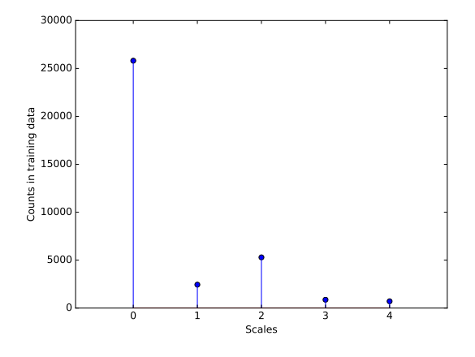
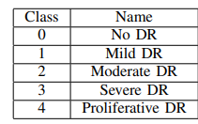
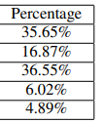
Literature survey (January-May)
REFERENCES | METHODS | FINDINGS | LIMITATIONS
PAPER 3 [1] (2022) | CONVOLUTIONAL NUERAL NETWORK | The kappa score of this CNN model is found to be 73.61% | Kappa score is less due to high complexity feature.
PAPER 2 [2] (2019) | Convolutional network structures: Net-5 and Net-4 + GAP + RAM |  | Kappa score is less Due to single-label classification
PAPER 1 [3] (2016) | DEEP CONVOLUTIONAL NUERAL NETWORK |  | Accuracy is very low due to Over-fitting
Figure 3.
Figure 4.
(8)

Slide 9
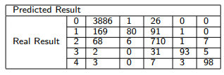
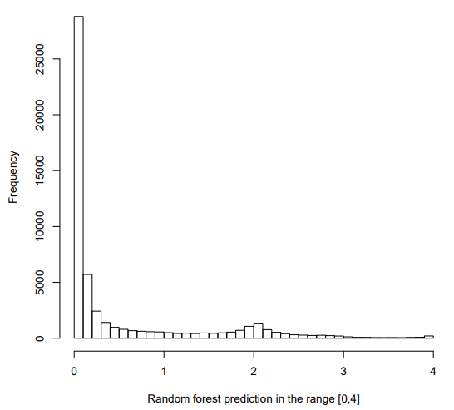
Literature survey (June-October)
REFERENCES | METHODS | FINDINGS | LIMITATIONS
PAPER 5 [13] (2023) | Deep Learning Algorithms and Quadratic kappa weights |  | No such limitations, But QWK can be improve
PAPER 4 [14] (2016) | Data Augmentation And Quadratic kappa weights |  | Low Accuracy due to low QWK , Unsuccessful Predictions
Figure 5.
Figure 6.
(9)

Slide 10
PREVIOUSLY ON...
DIABETIC RATINOPATHY DETECTION PRESENTATION

Slide 11
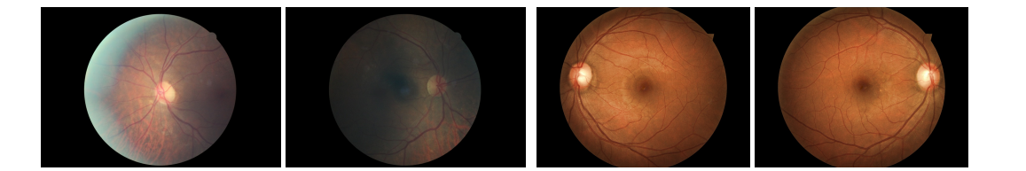
CNN based detection: Existing paper [1]
Dataset description:
Sample images of color retina images dataset
(11)
Figure 7.
Total images | 3662
No DR (class 0) | 1805
Mild DR (class 1) | 370
Moderate DR (class 2) | 999
Severe DR (class 3) | 193
PDR (class 4) | 295
Train Images | 3112 (85%)
Test Images | 550 (15%)

Slide 12
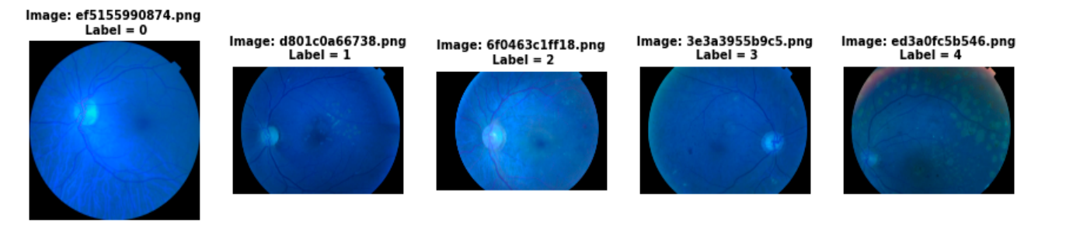
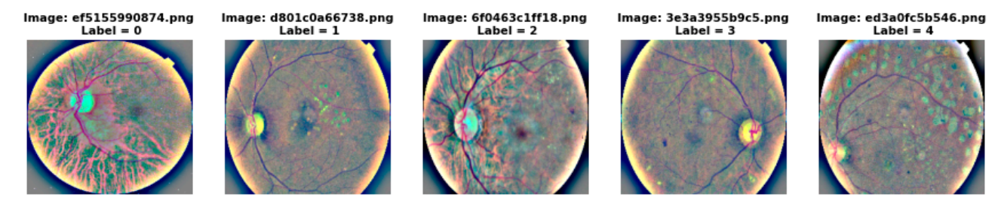
System 1: Image Pre – Processing and CNN[1]
Figure 8.
Figure 9.
Figure 8 (image before pre-processing) and Figure 9 (image after pre-processing)
label 0 => NO DR label 1 => mild NPDR label 2 => moderate NPDR label 3 => severe NPDR label 4 => PDR
(12)

Slide 13
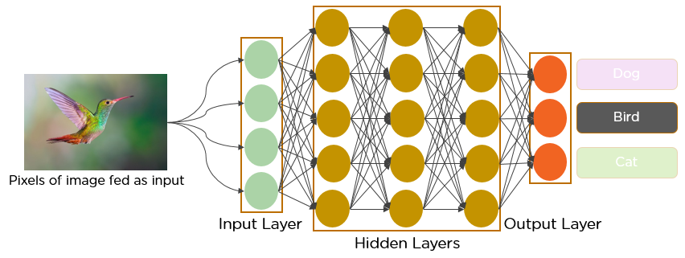
Existing Model
Convolutional neural network model:
(13)
Figure 10. CNN Model

Slide 14
Difficulties
Weak gradient flow Now these two issue can be resolve by using transfer learning
High complexity feature which is hybrid CNN with denseNet [1] [8] [9]
Single-label classification
this can be solve using multi-label classification to increase accuracy.
(14)

Slide 15
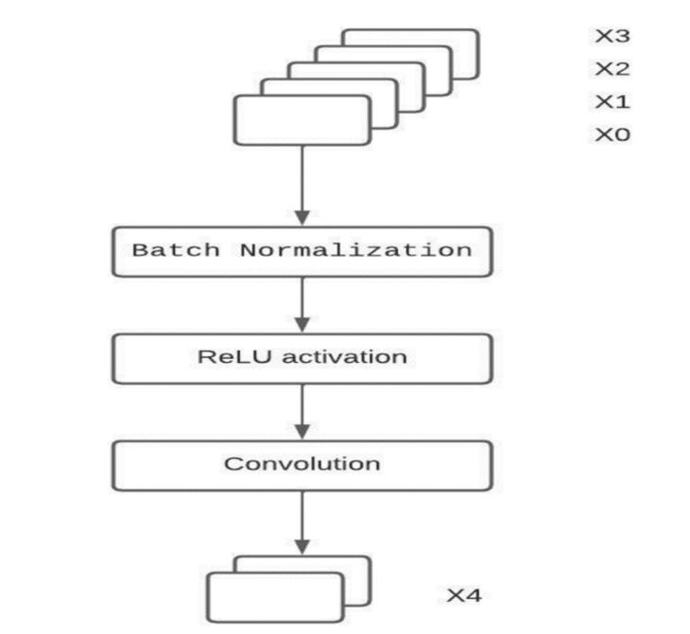
PROPOSED SYSTEM 2
Hybrid CNN with denseNet : Our Proposed Model
DenseNet aims at making the deep learning networks go deeper and deeper
short connections are used between the layers
flow of information is maximum
Figure 11.
(15)

Slide 16
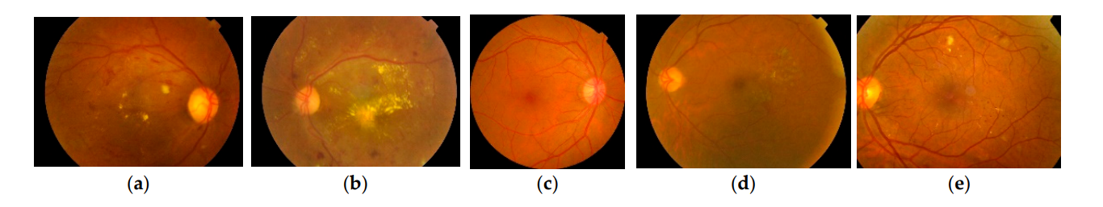
The model is trained for 15 epochs with 97 observations in each epoch (dataset of size 3662)
Avg. Accuracy score on the validation set was found to be 88.32% .
(16)
Figure 12.
label 0 => NO DR label 1 => mild NPDR label 2 => moderate NPDR label 3 => severe NPDR label 4 => PDR
(c) (d) (e) (a) (b)

Slide 17
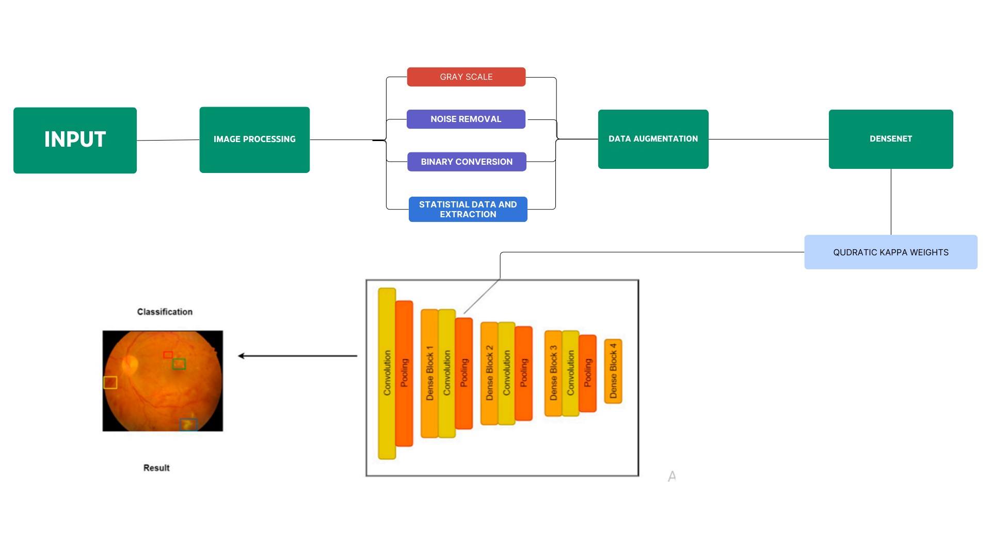
PROPOSED SYSTEM 3 : Block Diagram
(17)

Slide 18
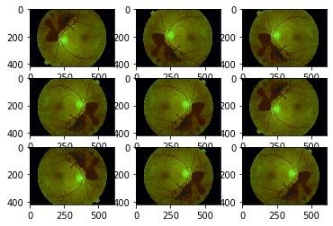
DATA AUGMENTATION[13]
For training, the images are
scaled (±10%)
rotated [0-360 deg]
skewed (±0.2).
For testing, the images are just rotated randomly . [13]
Figure 13. Augmented Retinal Fundal images
(18)

Slide 19
QUADRATIC KAPPA WEIGHTS (QWK) [14]
QWK :A metric to measure agreement between predicted and actual labels, considering them as ordinal.
Matrix Construction: Uses three matrices - expected (E), output (O), and weighted (W). E and O are derived from actual and target label vectors.
Weight Matrix: Calculated as,
W_ij = (i - j)^2/(k - 1)^2,
where i, j are labels and k is the number of classes.
Normalization: E and O are normalized by dividing them by their sum.
QWK Calculation: Calculated as
QWK = 1 - num /den,
where num and den are derived from element-wise multiplication of W with O and E, respectively.
(19)

Slide 20
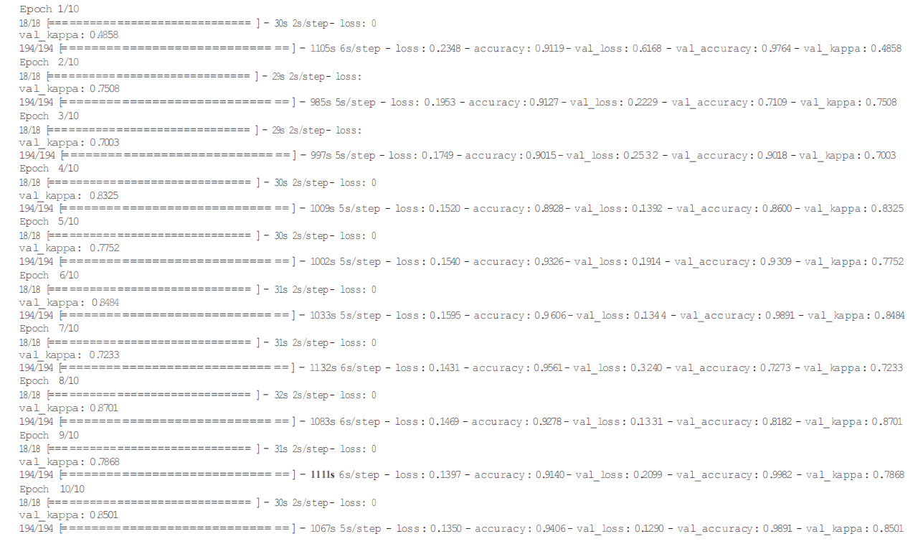
RESULTS
Avg Quadratic Kappa Score = 92.50 %
(20)

Slide 21
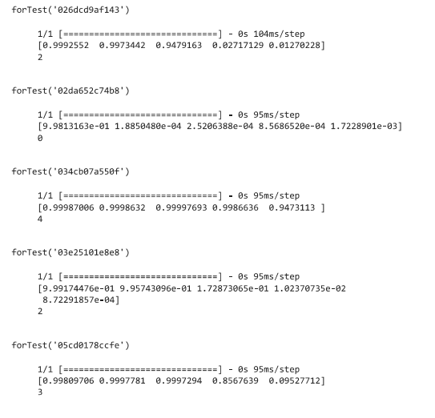
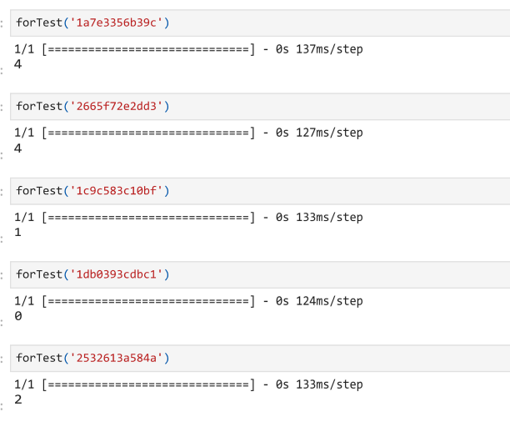
Comparison of performance
Prediction done by DenseNet Vs Prediction done by DenseNet
with quadratic kappa weights
(21)

Slide 22
Conclusion
This research presents the design and implementation of hybrid convolutional neural networks for automatic detection and classification of diabetic retinopathy from color fundus retinal images.
Based on the analysis and comparison of various methods, it can be concluded that deep learning algorithms along with transfer learning has a huge scope in predicting diabetic retinopathy.
In future there will be advancements of technology in medical field.
For better results and the accuracy of this model can be improved using other efficient optimization techniques.
The research can be enhanced with the user interface implementation for making it available in real time for the users
(22)

Slide 23
References
Diabetic Retinopathy Classification Using CNN and Hybrid Deep Convolutional Neural Networks. R., Y.; Raja Sarobin M., V.; Panjanathan, R.; S., G.J.; L., J.A. Symmetry 2022, 14, 1932, paper 1
Diabetic Retinopathy Detection via Deep Convolutional Networks for Discriminative Localization and Visual Explanation Zhiguang Wang, Jianbo Yang December 2, 2019, paper 2
Diabetic Retinopathy Detection using Deep Convolutional NeuralNetworks Darshit Doshi, Aniket Shenoy, Deep Sidhpura, Dr. Prachi Gharpure December 2016 paper 3
Intelligent automation of invoice parsing using computer vision techniques. Chazhoor, A.; Sarobin, V.R. Multimed. Tools Appl. 2022, 81, 29383–29403. [CrossRef]
Detection of novel coronavirus from chest X-rays using deep convolutional neural networks. Sanket, S.; Vergin Raja Sarobin, M.; Jani Anbarasi, L.; Thakor, J.; Singh, U. Narayanan, S. Multimed. Tools Appl. 2022, 81, 22263–22288. [CrossRef] [PubMed]
Predictive Analytics of COVID-19 Pandemic Kumar, S.L. : Statistical Modelling Perspective. Walailak J. Sci. Technol. (WJST) 2021,18, 15583. [CrossRef]
Available online: https://www.kaggle.com/competitions/aptos2019-blindness-detection/data?select=test_images (accessed on 13 June 2022).
diagnosis via denseNet
comparison of cnn and denseNet
The Need for Referral in Automatic Diabetic Retinopathy Detection. Pires, R.; Jelinek, H.F.; Wainer, J.; Goldenstein, S.; Valle, E.; Rocha, A. Assessing. IEEE Trans. Biomed. Eng. 2013, 60, 3391–3398. [CrossRef] [PubMed]
[F1]
[F2]
Kaggle Diabetic Retinopathy Detection competition report Ben Graham August 6, 2015 paper 3
A Reliable Diabetic Retinopathy Grading via Transfer Learning with Quadratic Weighted Kappa Metric, Sai Venkatesh Chilukoti, Liqun Shan, Anthony S Maida, and Xiali Hei February 11, 2023 paper 4
(23)

Slide 24


